Slide 1
Review
1st. Elementary module

Slide 2

Agenda
Review
Spelling, numbers and countries.
Jobs, asking for details and demonstratives.
Adjectives, family members and possessives.
Time and prices.
English verbs, special dates and adverbs of frequency.
Food and present simple tense.

Slide 3

Learning objectives
The student will be able to review the elementary level of English.
The student will be able to adopt the content into practical settings.

Slide 4

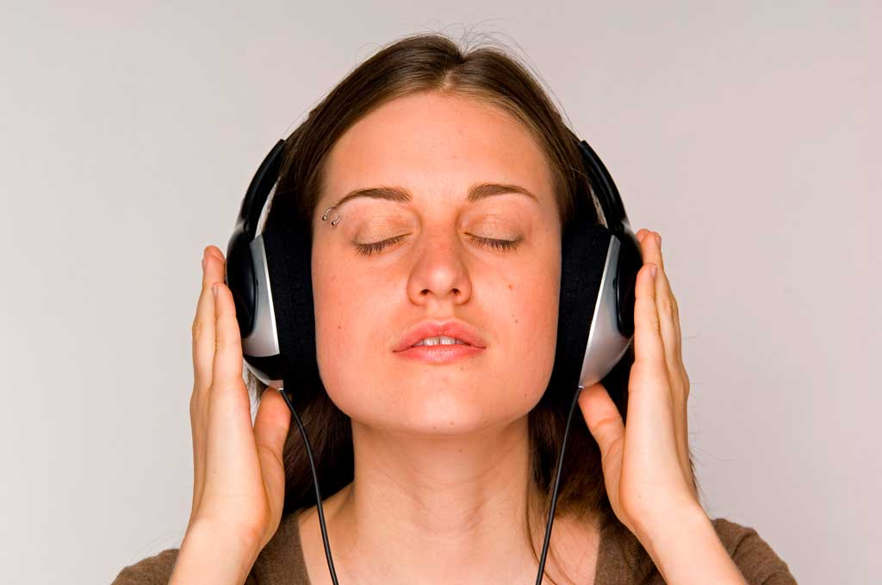
Teacher
Director
Customer service assistant
Retired
Unemployed
Coordinator
Pilot
Say seven:
Jobs
Free time activities
Do yoga
Make craft
Play video games
Go to the theater
Attend to concerts
Watch TV
Listen to music

Slide 5
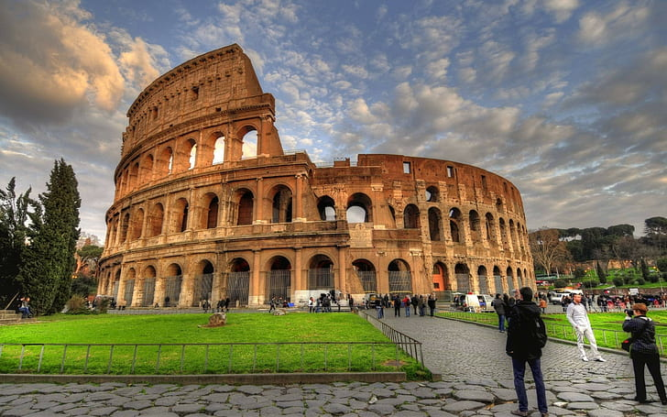
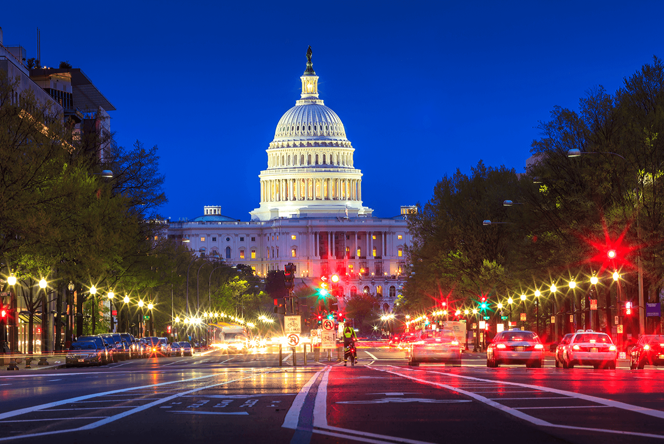
Make a question with Where…?
Her mother goes to Rome
Tom’s sister lives in the USA
Where does her mother go?
Where does Tom’s sister live?

Slide 6

Describe…
She’s Nicole Kidman, she’s an Australian actress. She’s tall and thin. Nicole’s got curly ginger long hair. She’s got big blue eyes. Her most famous movie is Cold mountain, from 2003.
A famous artist
A person in your family

Slide 7

How do you say these prices and numbers?
€20.50
$133.20
1986
0122035578999
3.5
759
£5.90
Twenty euros, and fifty cents.
One hundred thirty-three dollars, and twenty cents.
Nineteen eighty-six.
Oh! – One – Double two – Oh! – Three – Double five – Seven – Eight – Triple nine
Three dot five
Seven hundred fifty-nine
Five pounds, and ninety pence.

Slide 8
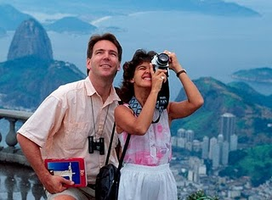
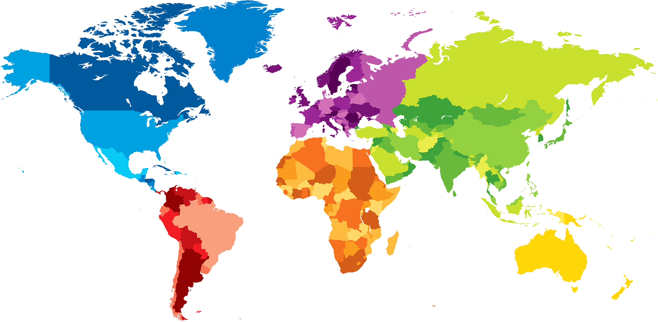
Say eight:
Spain
Hungary
Malta
Switzerland
Australia
Countries
Languages
Russia
Ukraine
Iceland
Kenya
Spanish
Hungarian
Maltese
English
Russian
German
Ukrainian
Icelandic

Slide 9
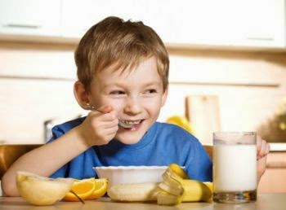
Make a sentence with these words.
Get up /usually /I /at /o’clock /eight
She /in /New York /lives /city
Doesn’t /like /He /to /eat / fruit /fresh
I usually get up at eight o’clock
She lives in New York city
He doesn’t like to eat fresh fruit

Slide 10
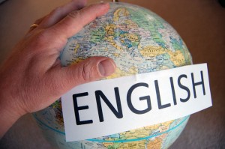
Make a question with these words.
Your /dad’s /What /name? /is
How /do /drink /often /you /water?
Do /we /Why /English? /study
What’s your dad’s name?
How often do you drink water?
Why do we study English?

Slide 11

What is the infinite of these verbs?
Drinks
Eats
Travels
Does
Goes
Chooses
Has
Drink
Eat
Walks
Talks
Screams
Whispers
Whistles
Puts
Comes
Travel
Walk
Do
Talk
Go
Scream
Choose
Whisper
Have
Whistle
Put
Come

Slide 12
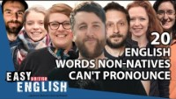
Tricky words in English
V-E-G-E-T-A-B-L-E-S
S-I-X-T-H
L-E-I-C-E-S-T-E-R
D-E-V-E-L-O-P-E-D
C-O-L-O-N-E-L
C-H-O-I-R
C-O-LL-O-Q-U-I-A-LL-Y
M-A-SS-A-C-H-U-S-E-TT-S

Slide 13
Say seven types of:
Burger
Ice cream
Fried fish
Food
Drink
Wine
Coke
Water
Scotch
Milk
Lemonade
Yoghurt
French fries
Steak
Rice
Baked beans

Slide 14

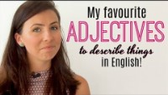
What is the opposite?
Magnificent
Remarkable
Obvious
Cheap
Unfriendly
Fast
Clean
Boring
Poor
Noisy
Dumb
Expensive
Acceptable
Friendly
Impossible
Slow
Dirty
Funny
Rich
Quiet
Smart

Slide 15
Grandma
Godfather
Uncle
Nephew
Cousin
Sister
Wife
Father
Say five family members.
Male
Female
Both
OK
OK
OK

Slide 16
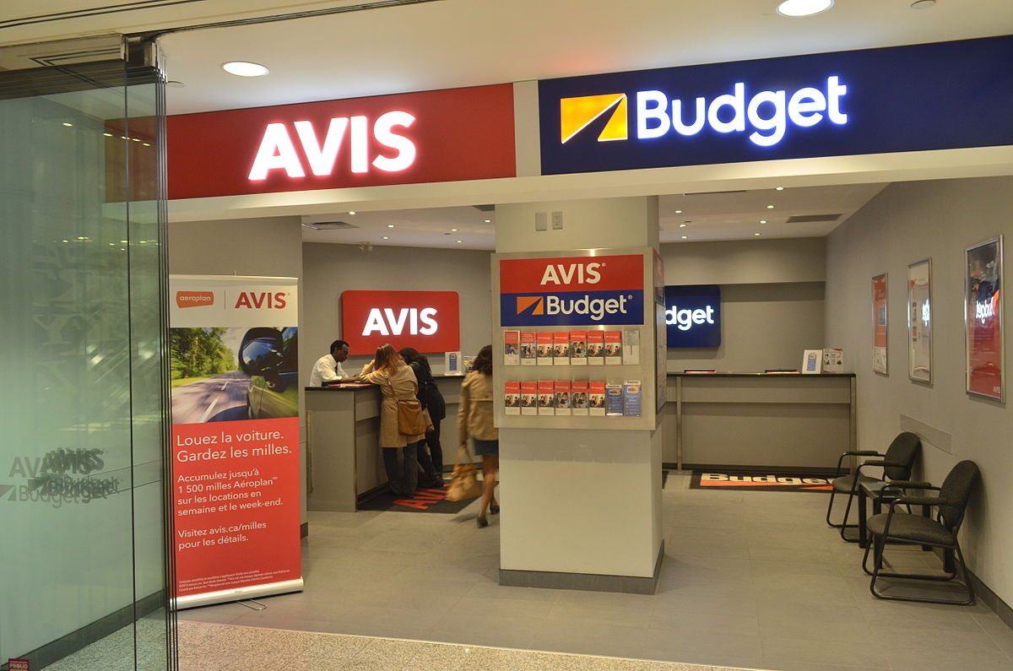
How do you ask for personal details...
First name
Surname
Nationality
Address
Post code
Mobile number
Phone number
Email address
What’s your first name?
What’s your surname?
What’s your nationality?
What’s your home address?
What’s your post code?
What’s your mobile phone number?
What’s your home phone number?
What’s your email address?

Slide 17


Say three words that you use in…
American English
British English
Candy
Potato chips
Parking lot
Sweets
Crisps
Car park
Sweets

Slide 18
Talk about things you do in…
Go to the movies
Attend to concerts
Eat out
Go to the museum
Your town or city.
Your travel destination.

Slide 19
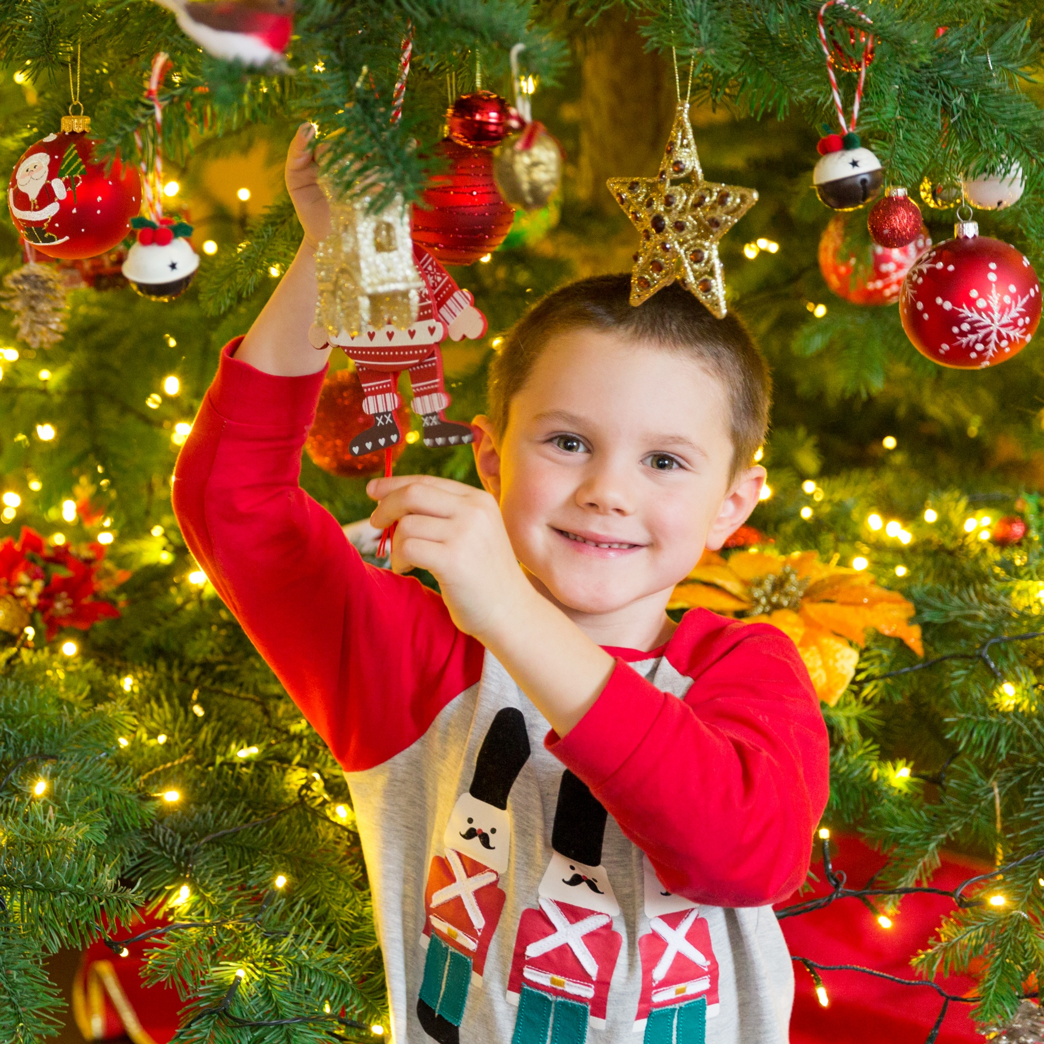
I take a shower
I start work
I go to bed
I have breakfast
I go for a walk
Talk about your daily routine in the week.
At the weekdays
At the weekends
On special dates

Slide 20

Make the sentence negative.
We watch TV at weekends.
I drink coffee in the morning.
Matt lives near to Cartagena’s beach.
We don’t watch TV at weekends.
I don’t drink coffee in the morning.
Matt doesn’t live near to Cartagena’s beach.

Slide 21
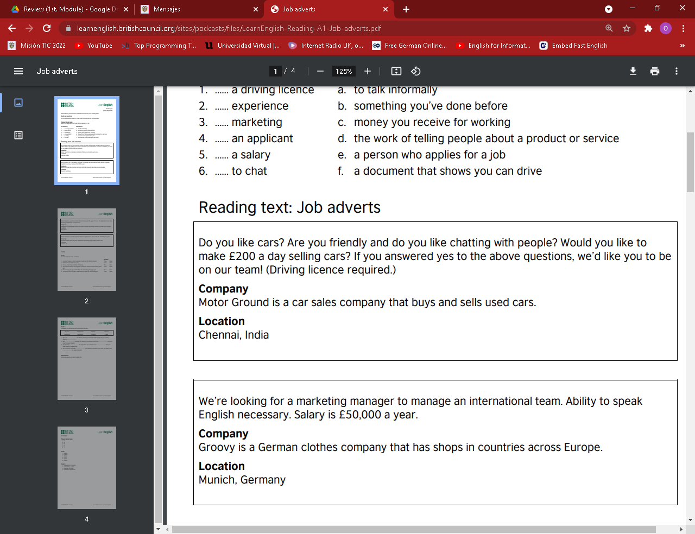
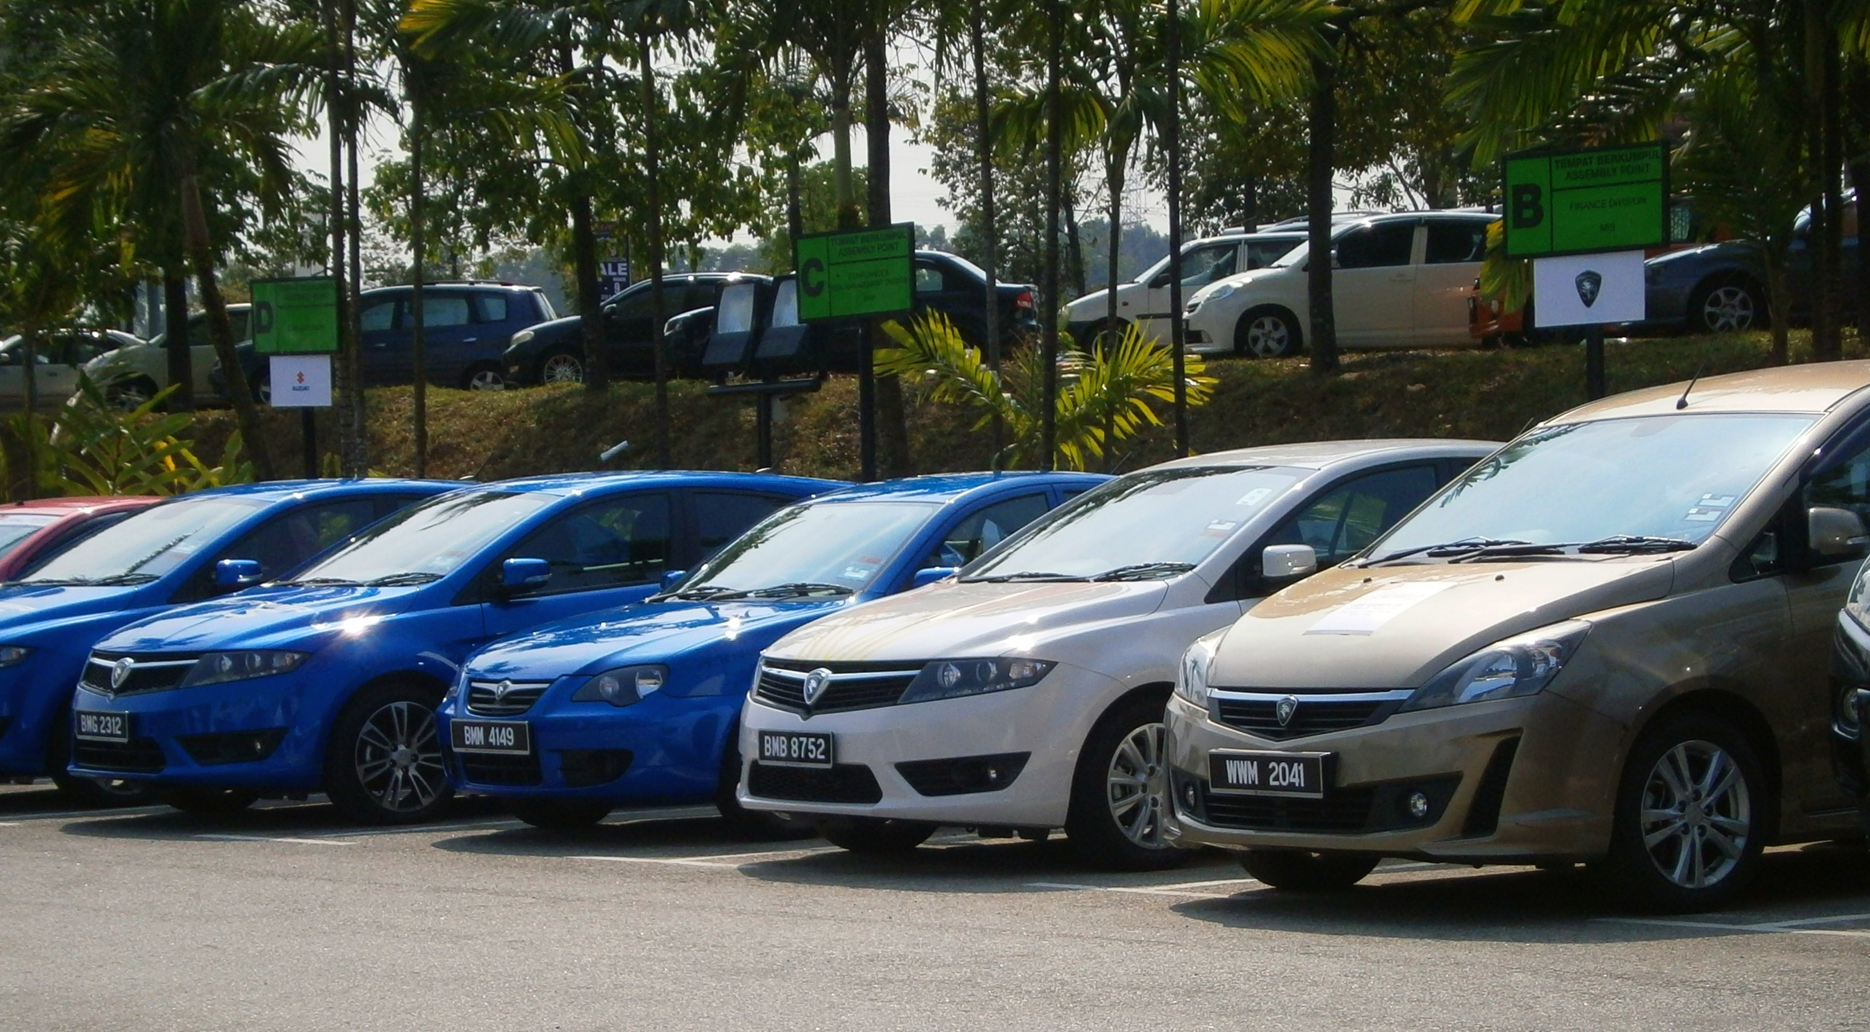
Reading: Job adverts
Where do you have to work?
Do you need to know how to drive?
Do they sell new cars?
Chennai, India
Yes
No

Slide 22
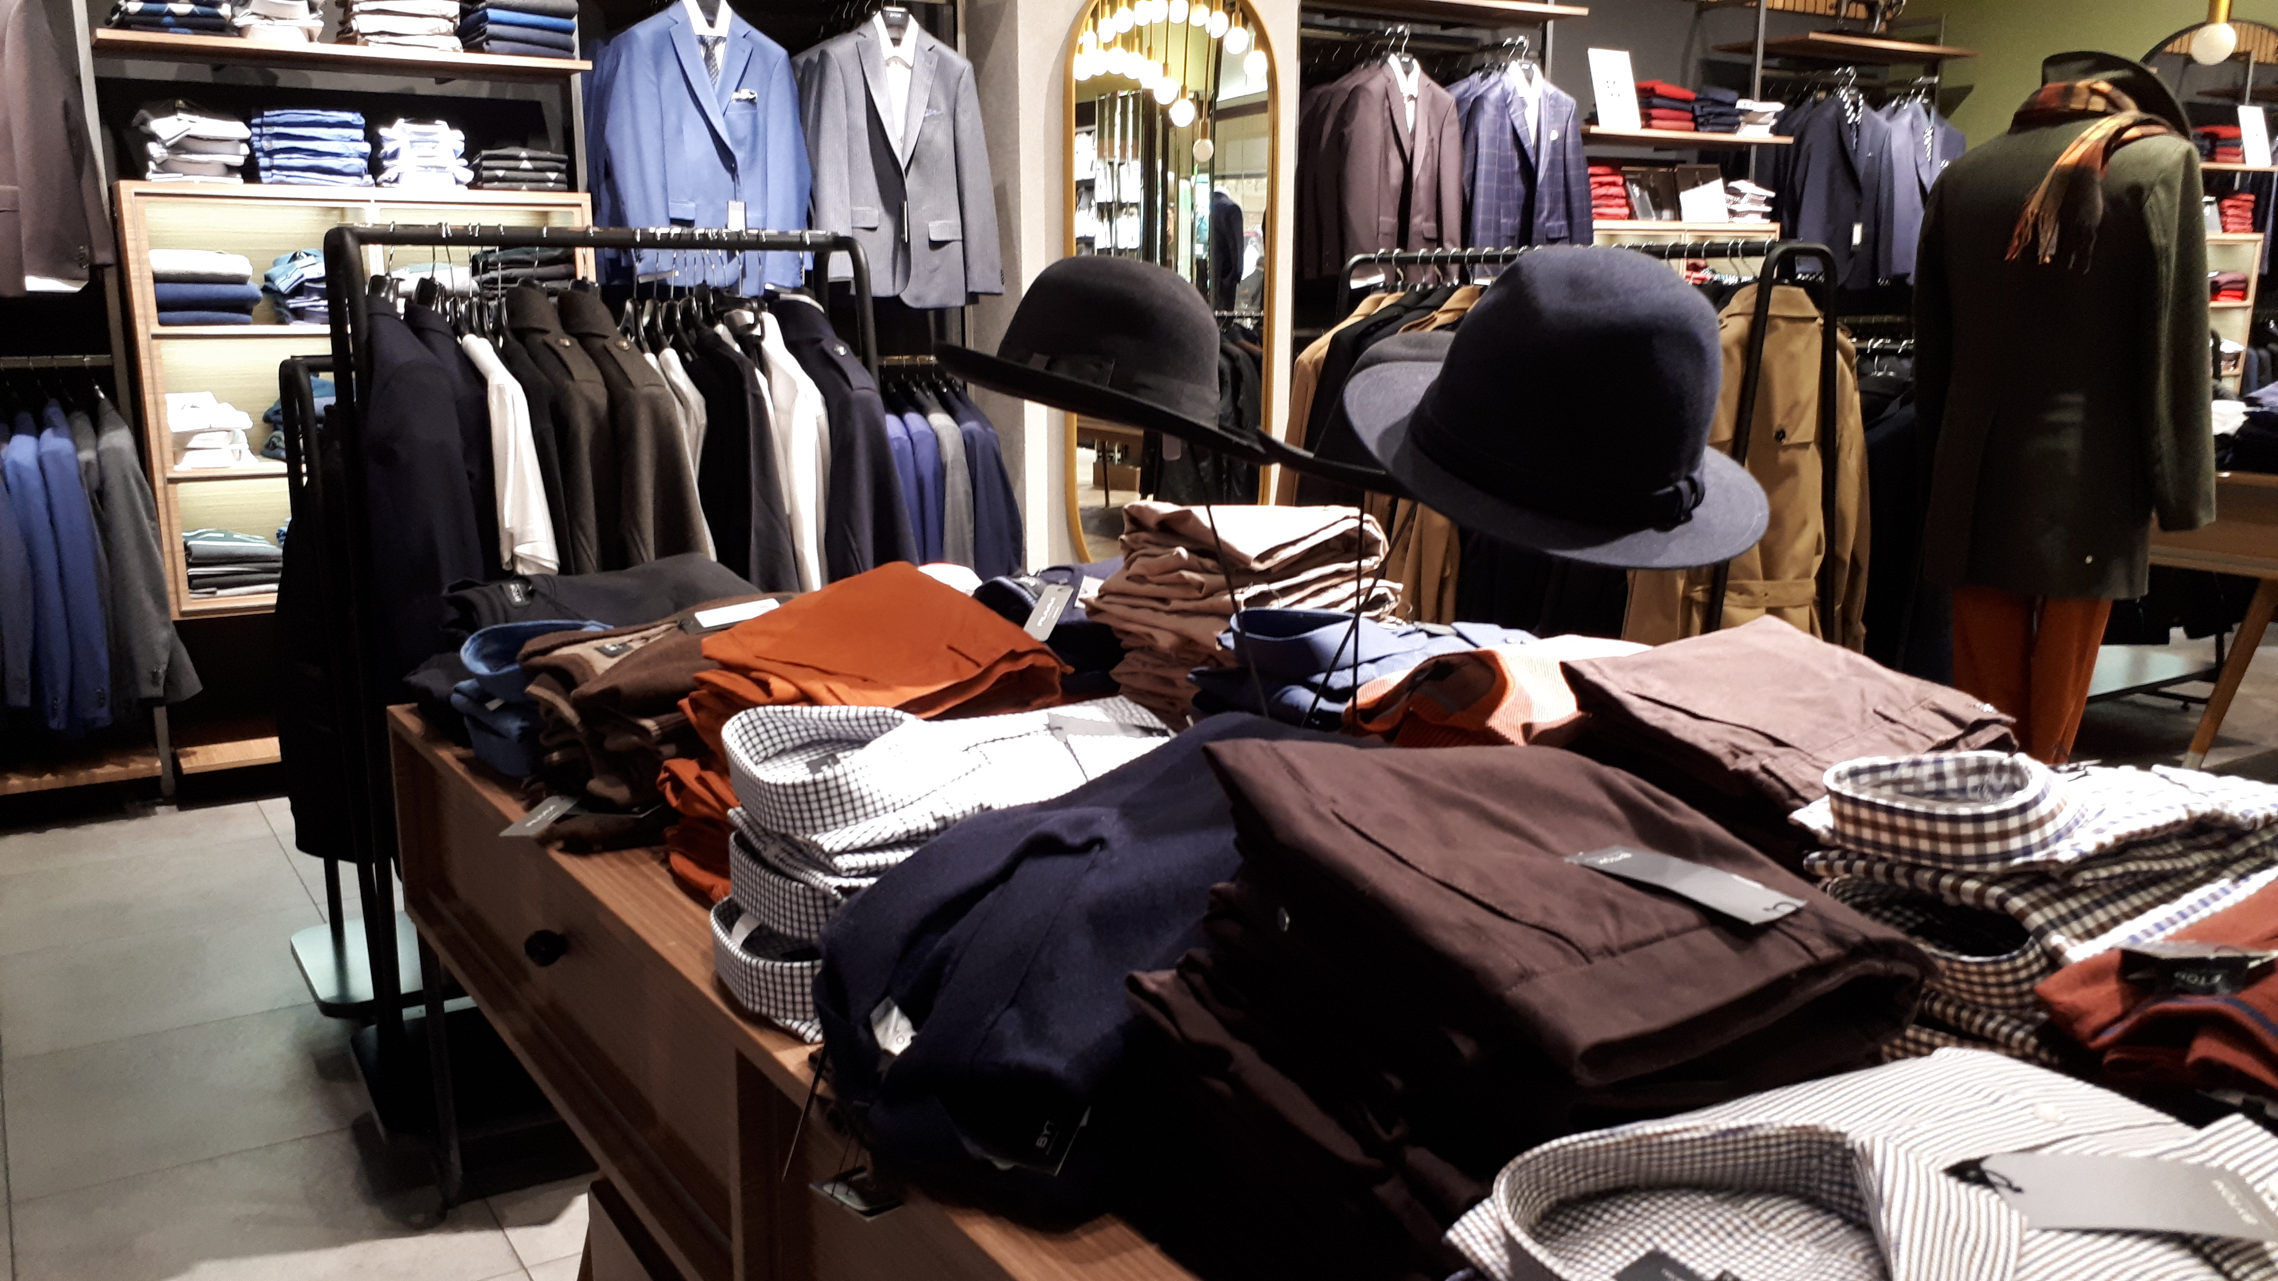
Job adverts II
Do you need to speak German?
Is your salary in British pounds?
What’s the job position?
No
Yes
A marketing manager
https://learnenglish.britishcouncil.org/sites/podcasts/files/LearnEnglish-Reading-A1

Slide 23


